Slide 1
Looped Systems
By Quang Huynh

Slide 2
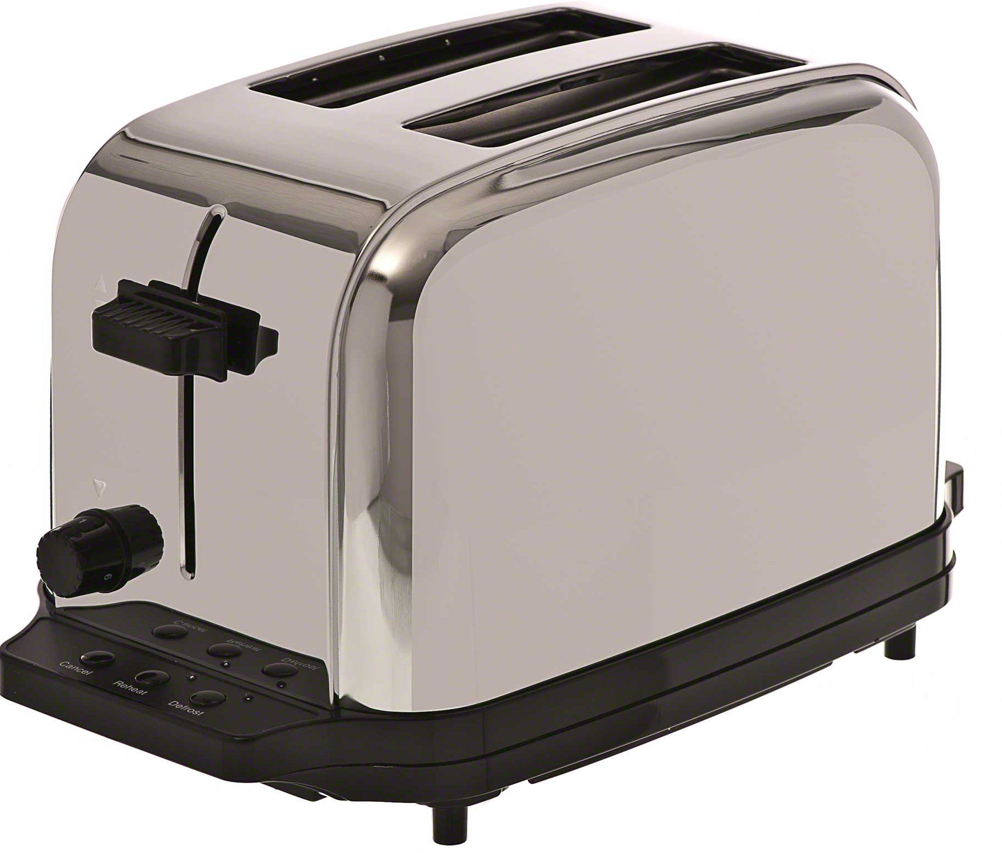
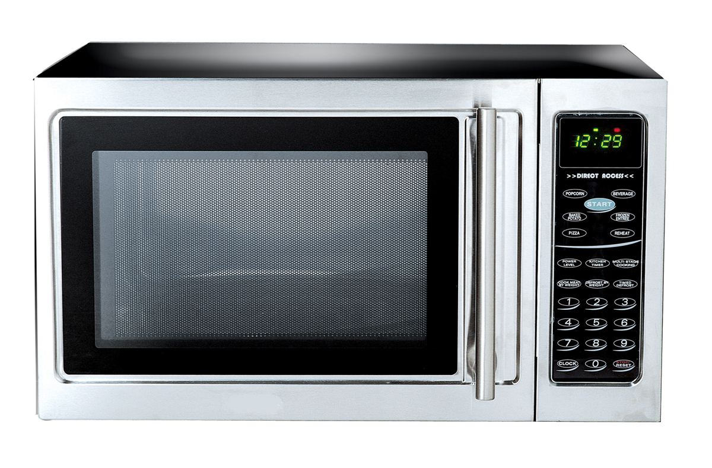
Open Loop:
I can set a time for a microwave, which would delay the switch for turning it off.
Closed Loop: The toaster can detect if the bread is hot enough with a heat sensor.

Slide 3
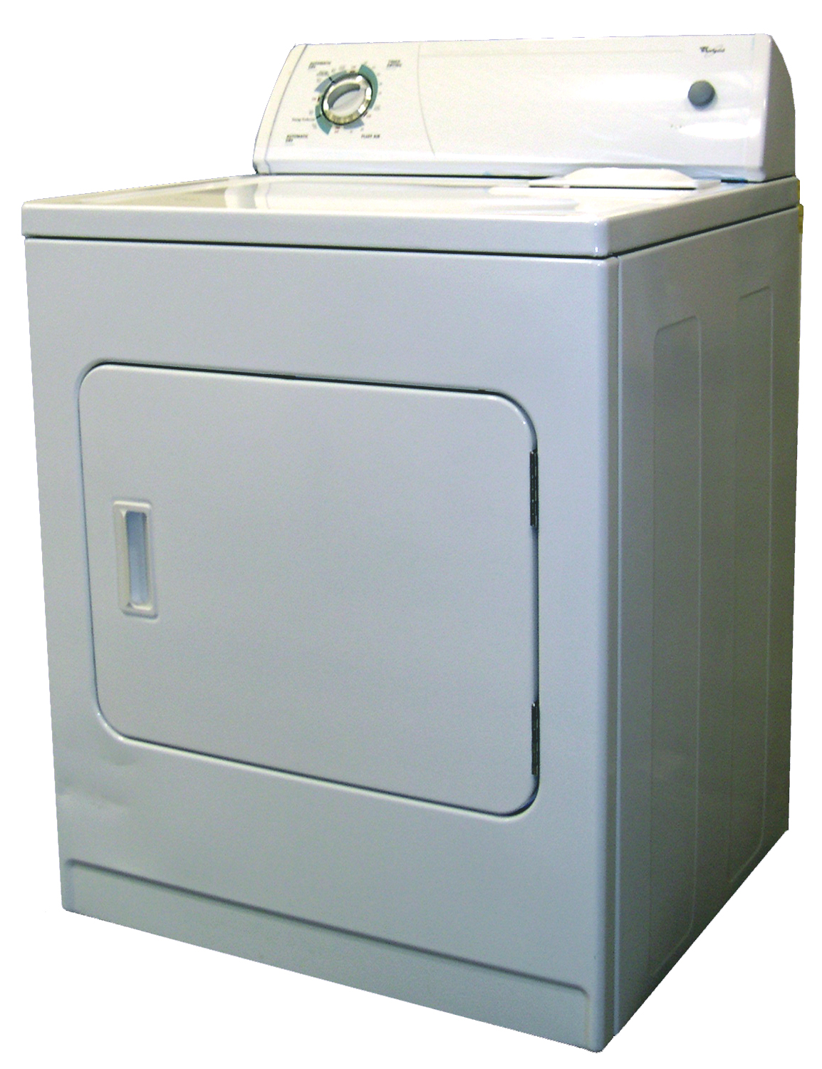
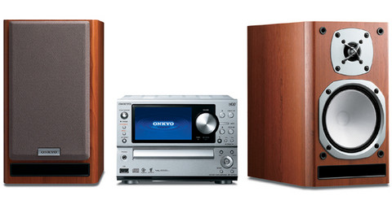
Open Loop:
The volume of a stereo can be changed and altered.
Closed Loop:
My dryer is a closed loop system because it can monitor moisture.

Slide 4
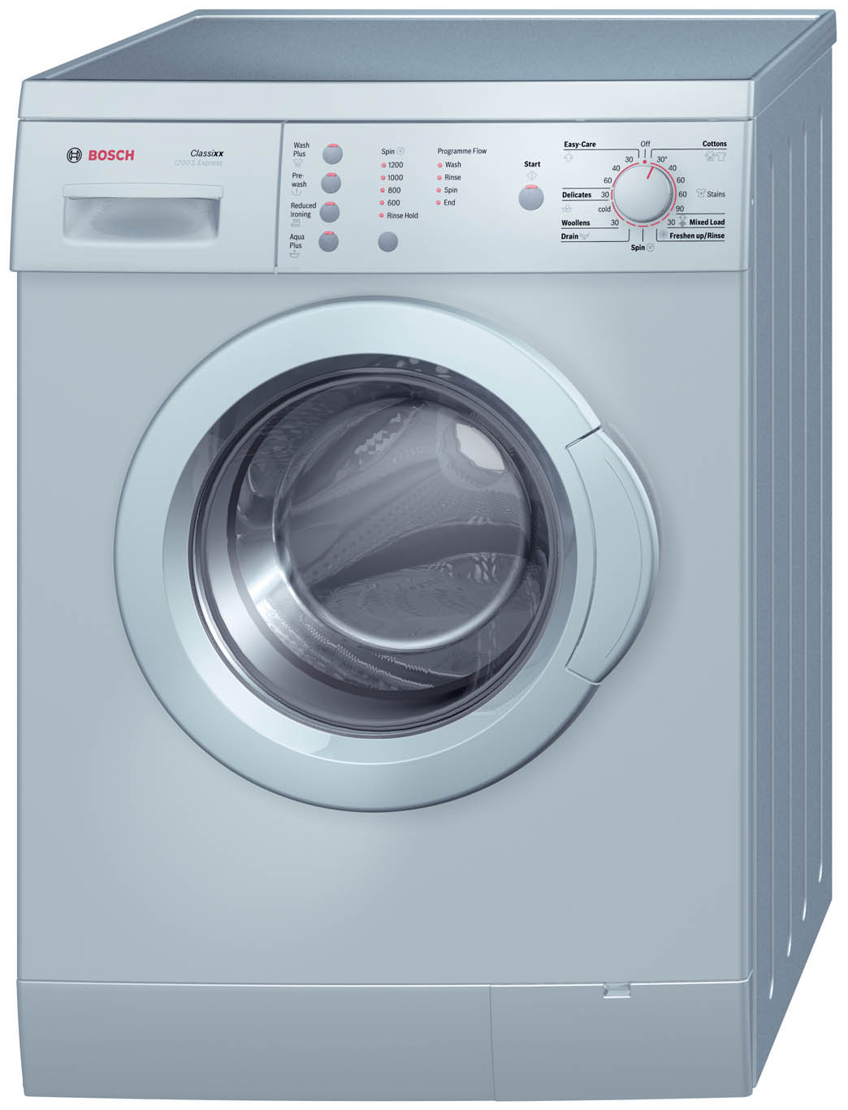
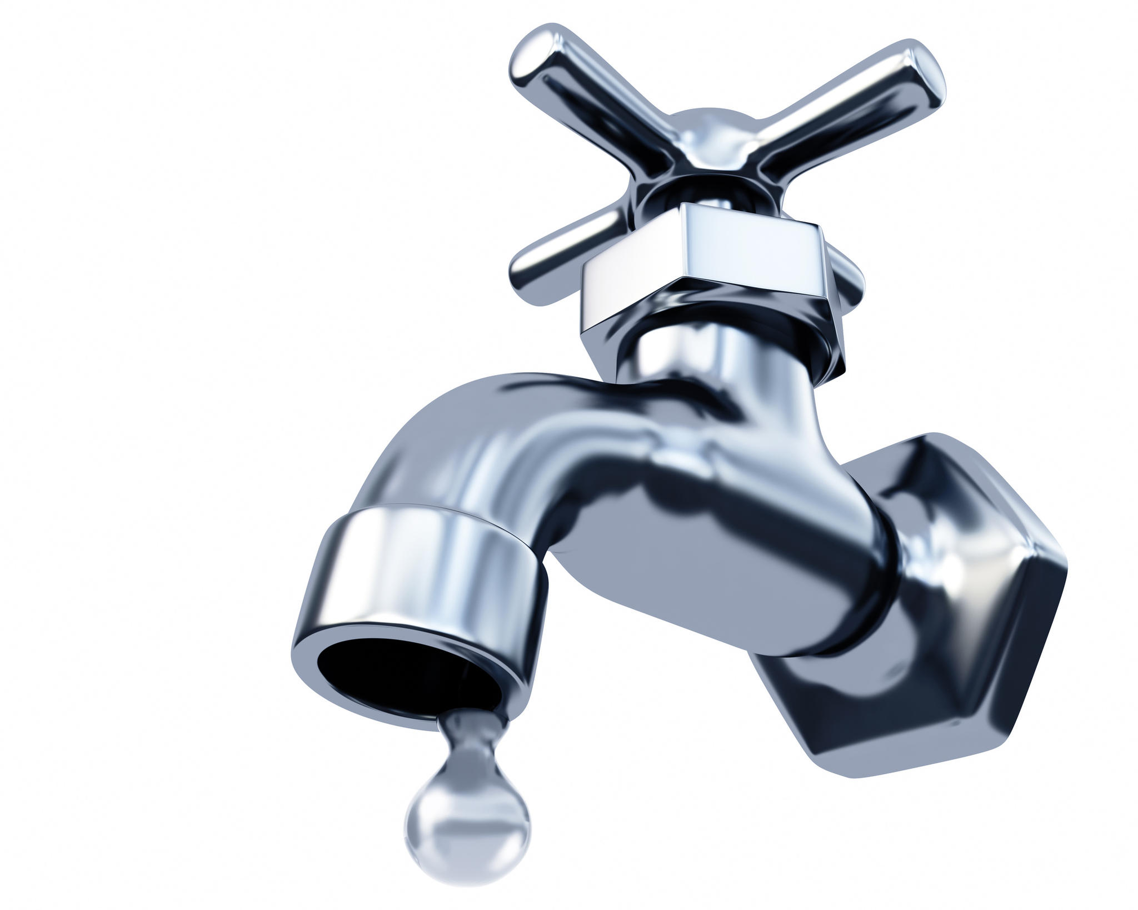
Open Loop:
The amount of water can be controlled with a faucet.
Closed Loop: The washing machine monitors the water level.

Slide 5
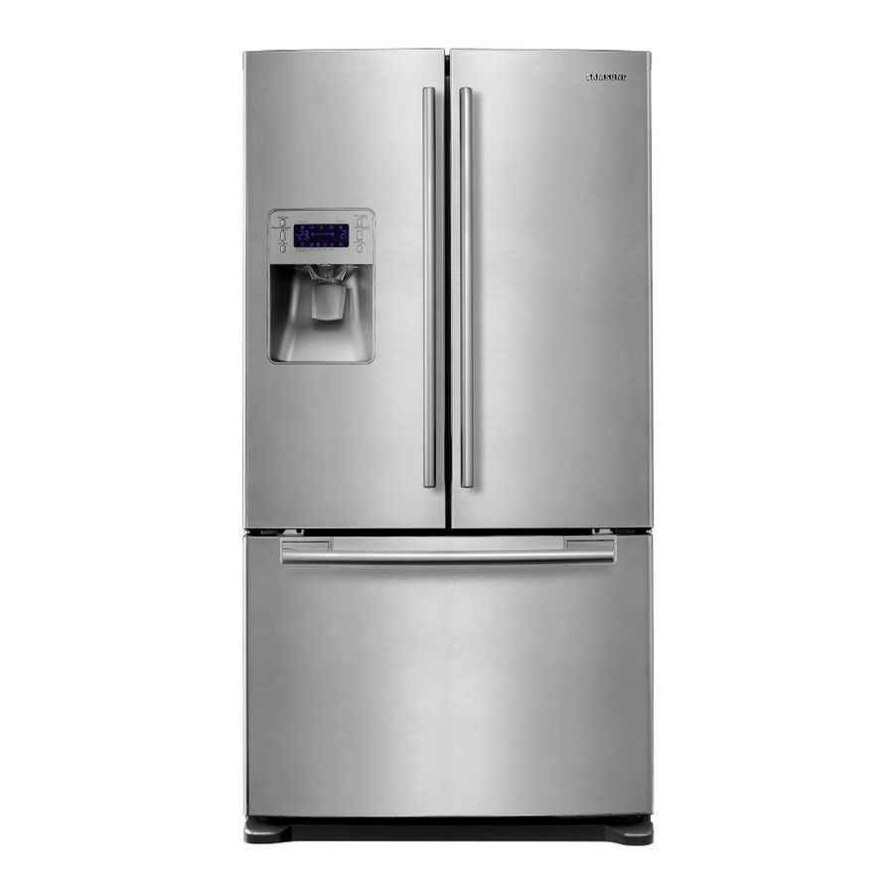
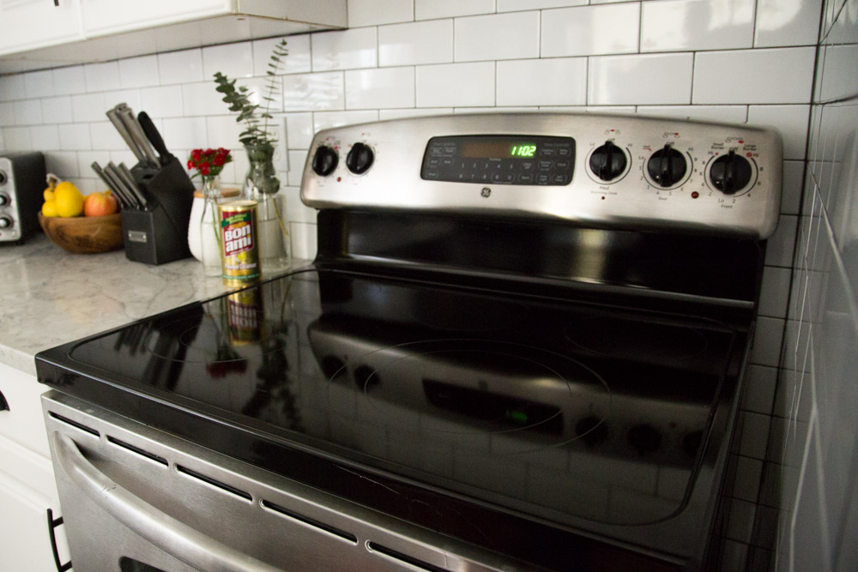
Open Loop:
The temperature setting for a stovetop can be changed.
Closed Loop:
The temperature inside of the refrigerator is constant.
This Photo by Unknown Author is licensed under CC BY-NC-ND

Slide 6
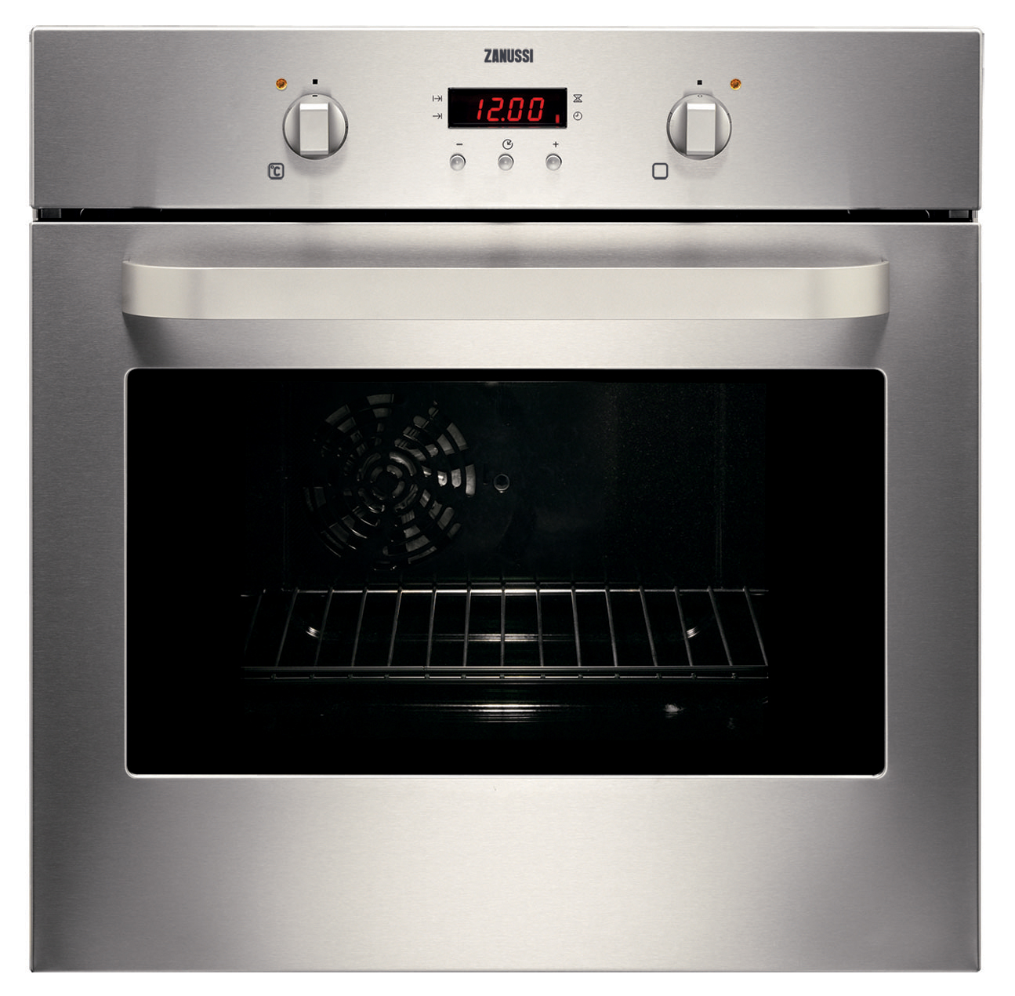
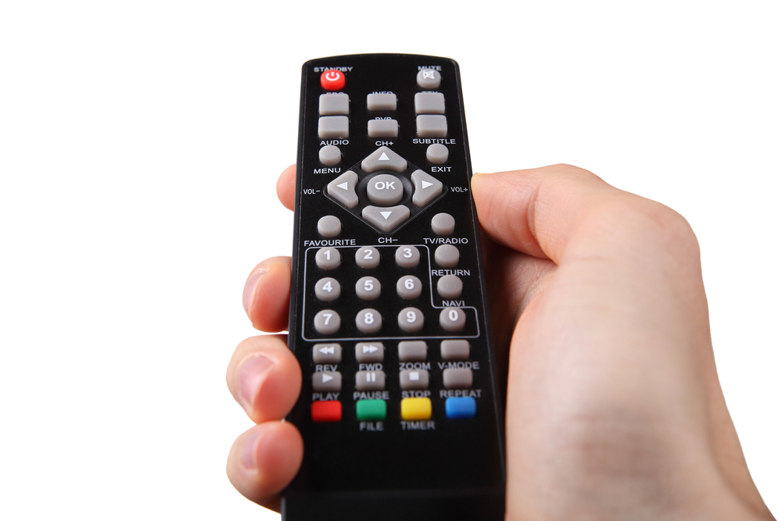
Open Loop:
The TV remote can turn off and turn on the TV.
Closed Loop:
The temperature of the oven is constant.

